Slide 1

Making the Most of Development Dollars in Liberia
Reinforcing Results-Based Financing in the Health Sector
Notes:
In Liberia, Social Impact supported the USAID Mission to figure out the best way to make the most of their development dollars by reinforcing results based financing in Liberia’s heath sector.

Slide 2
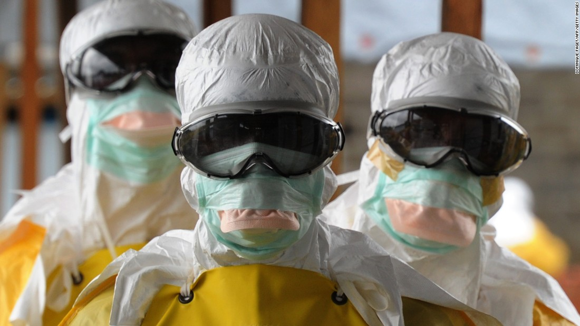
Ebola Devastates the Health System
Health facility deliveries fell by 91%
Pediatric admission for malaria fell by 85%
Treatment of new HIV patients fell by 57%
Source: WHO
Notes:
From 2014 to 2015, Liberia’s Health sector was devastated by the Ebola Virus Disease. Some health facilities shut down while others operated with limited supplies, resources and staff. Liberians throughout the country had less access to the health care and resources they need to live healthy lives.

Slide 3




Rebuilding Health Services by Paying for Results
Results-Based Financing (RBF)
Agree on Services & Results
Deliver Services
Verify Results
Reimburse Cost
Notes:
To rehabilitate the health sector, USAID decided to expand its results-based financing (RBF) program with the Ministry of Health (MOH).
Here USAID gives money directly to the Ministry, but rather than basing payments on inputs like electricity bills, salaries and vehicles, they base payments on results like the number of health workers trained, the number of mosquito nets available or the number of women receiving pre natal exams.
This structure is a win win situation as the US government can reduce its own risk by only paying for results and the Government of Liberia can decide how exactly it will spend its money to achieve their goals.

Slide 4
Data Drives Results-Based Financing
Social Impact…
Evaluates
Services & Results
Assesses Services
Verifies Results
Costs
Deliverables
Notes:
To pay for results, USAID Needs Data. This is where SI comes in. SI Provides USAID and the ministry of health with four kinds of data.
First, through focus group discussion, interviews and data analysis, SI identified what results would actually be the most relevant, effective and reasonable to be included in the agreement between the Ministry of health and USAID
Second, through identifying quality standards and assessing services, SI ensures that the services provided to the Liberian public meet the quality standards of care.
Third, by conducing verification visits, SI was able to ensure that the results reported by government actors are accurate and verified—holding service providers accountable to their results.
Finally, through a costing analysis, SI provided the information that USAID needed to ensure that they were paying an appropriate fee for each of the deliverables

Slide 5
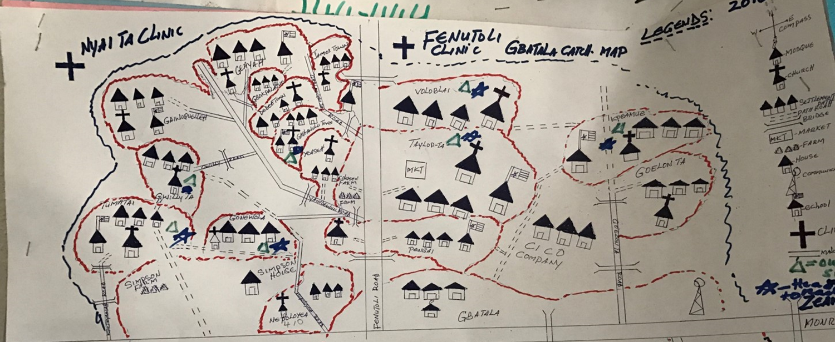
Impact: Data Helps us Do More with Less
With this data, the Government of Liberia was able to provide more services for the same amount of money.
Notes:
SI’s blended services ultimately gave USAID and the MOH the data they needed to continuously improve this process. The improvements came in many ways.
First, with effective data in the performance evaluation, USAID and MOH were able to accurately cost the deliverables and plan better for those results. With SI’s evaluation in particular USAID and the MOH recognized that they were over valuing certain deliverables and re-costed the agreement to expand services within the existing $24 million dollar limit—providing more health services to Liberians with the same amount of money in hand.

Slide 6
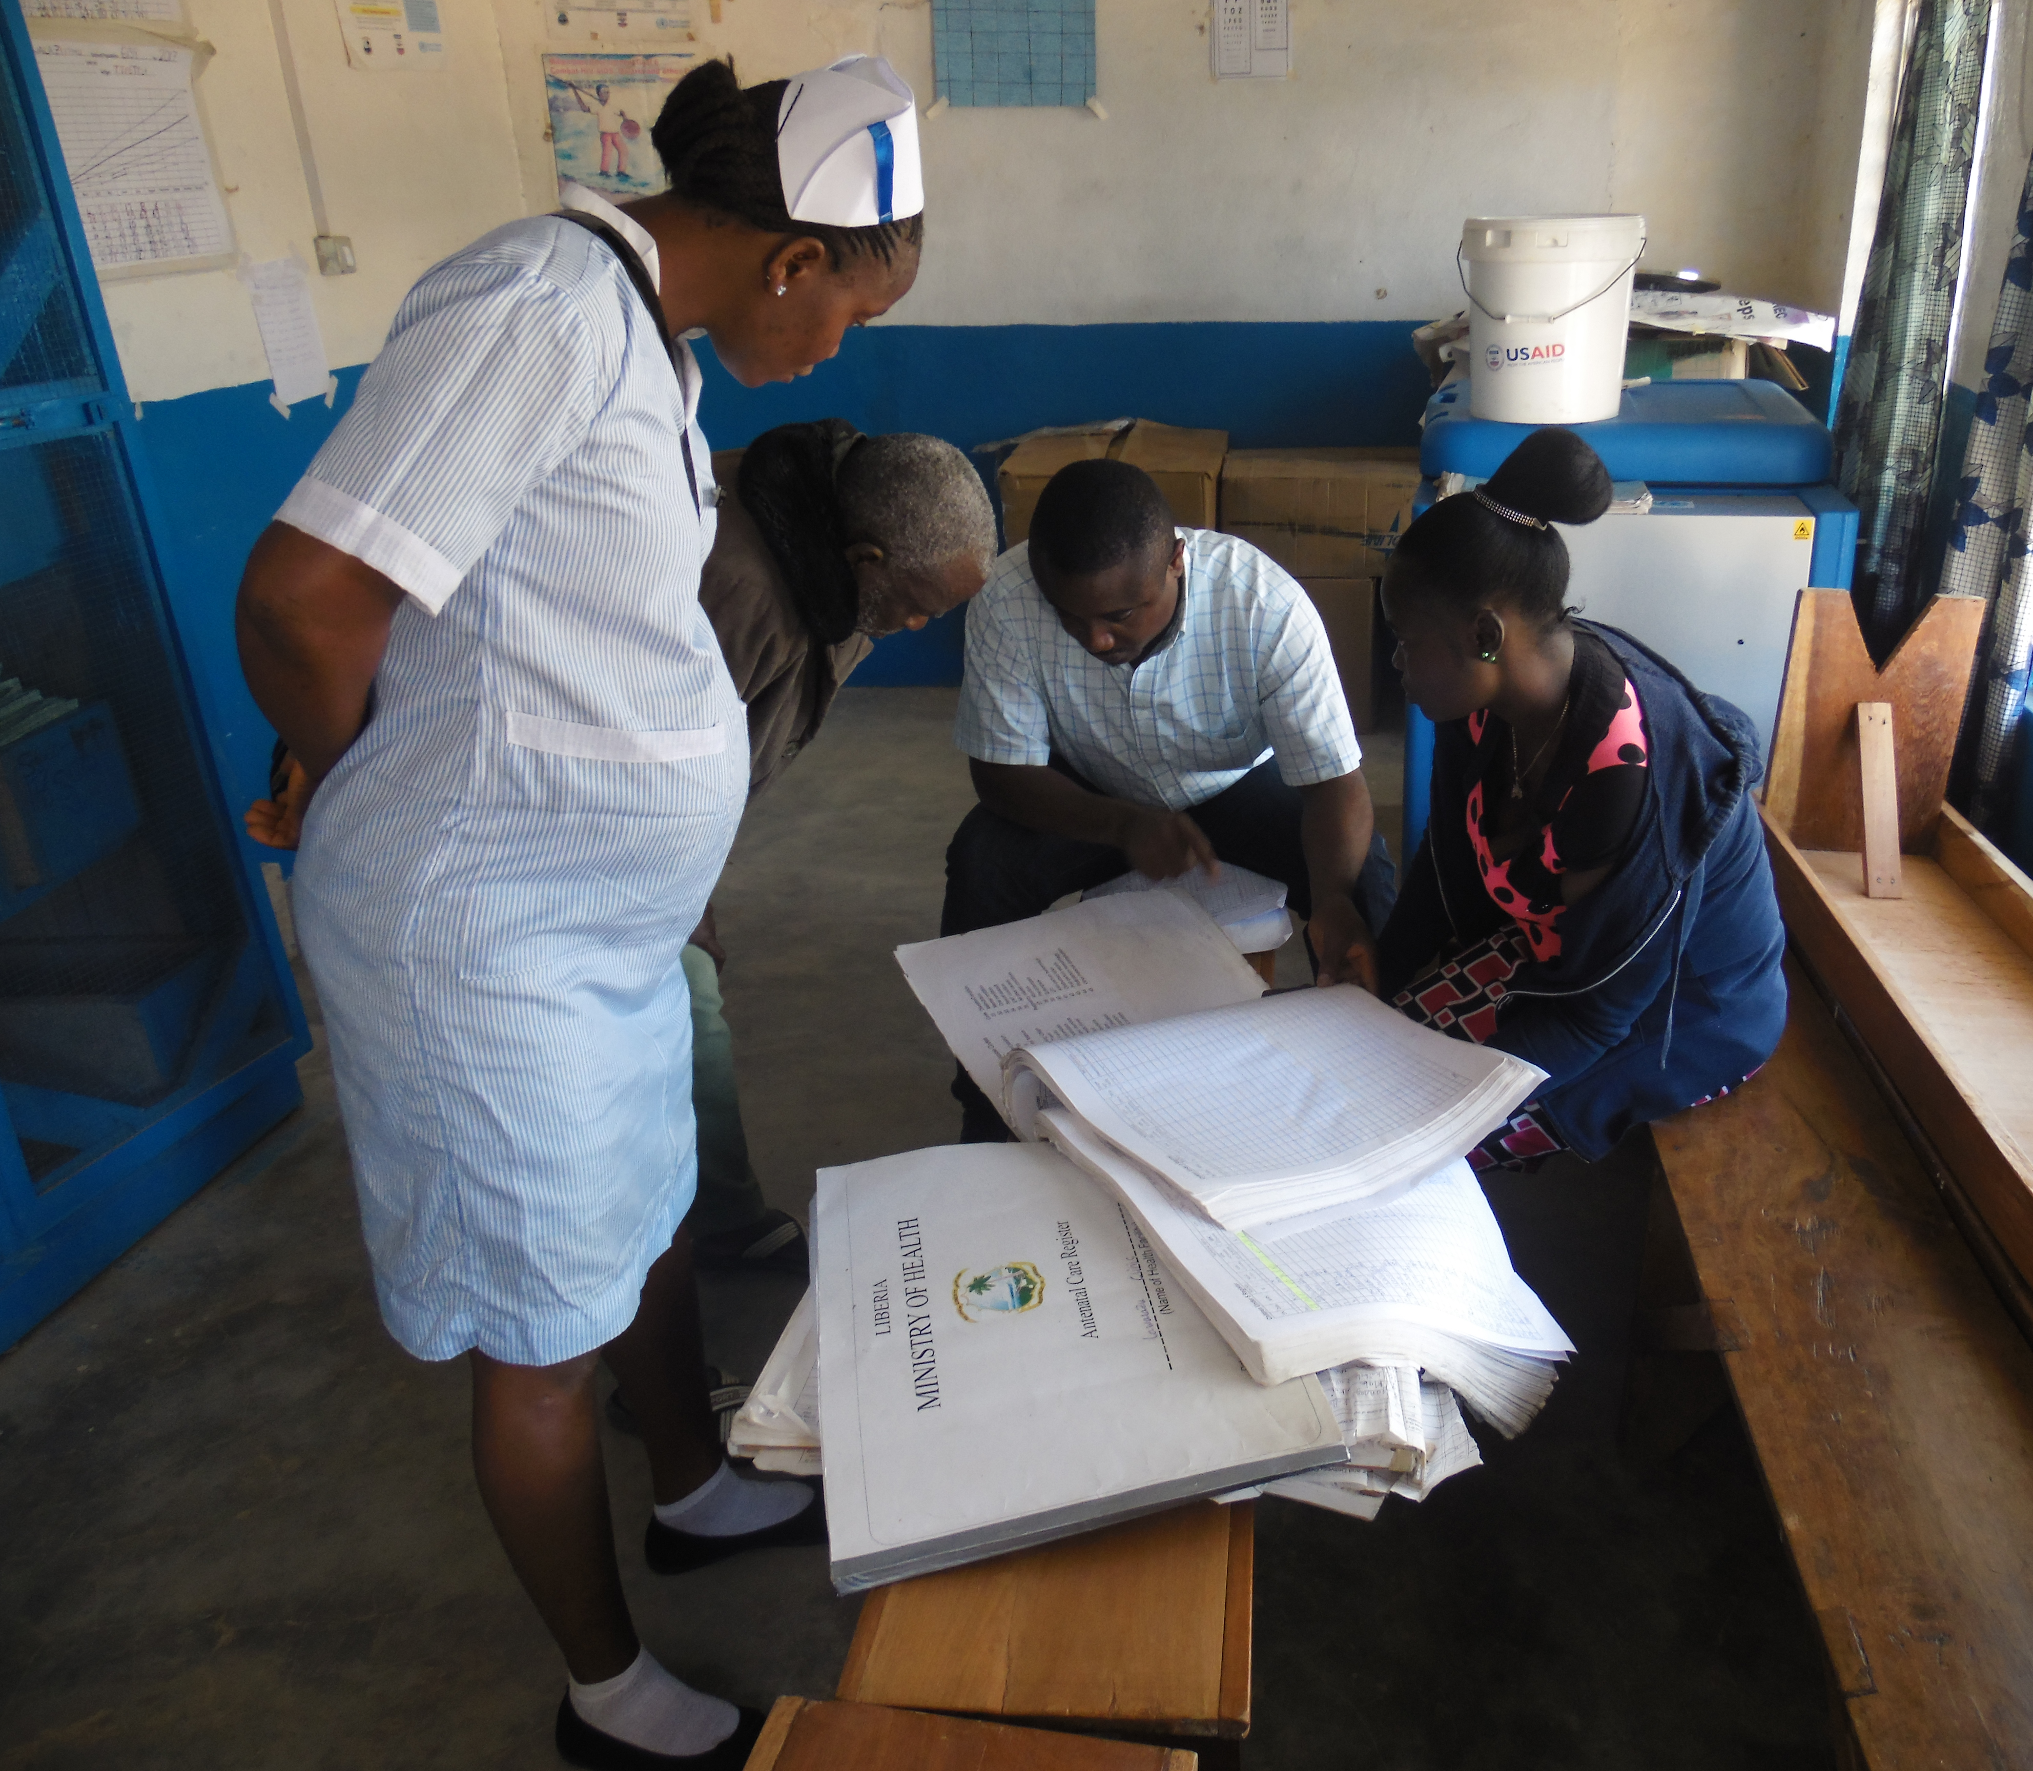
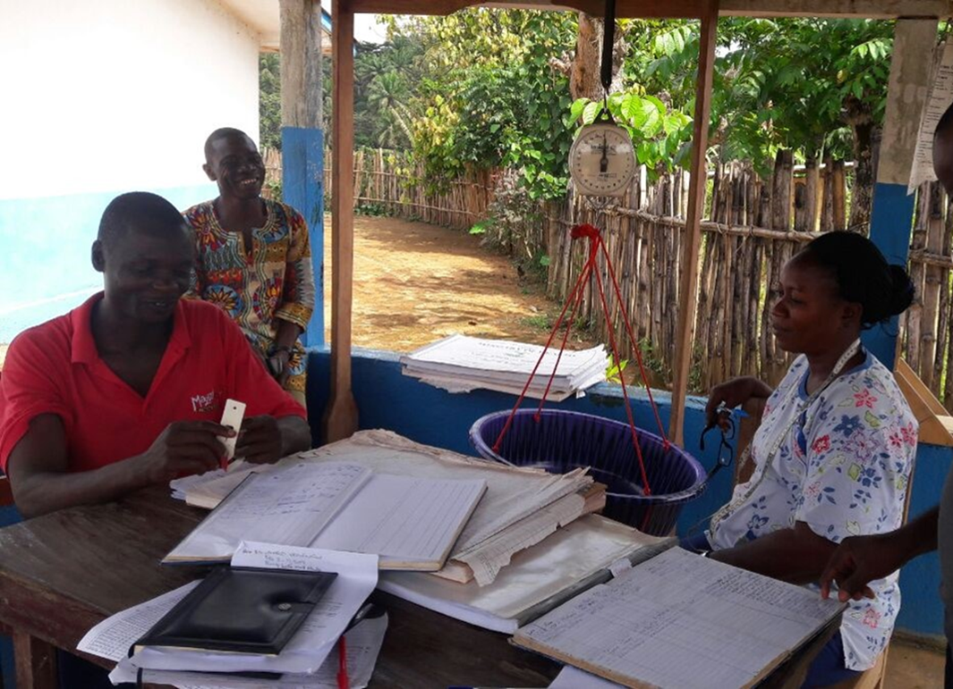
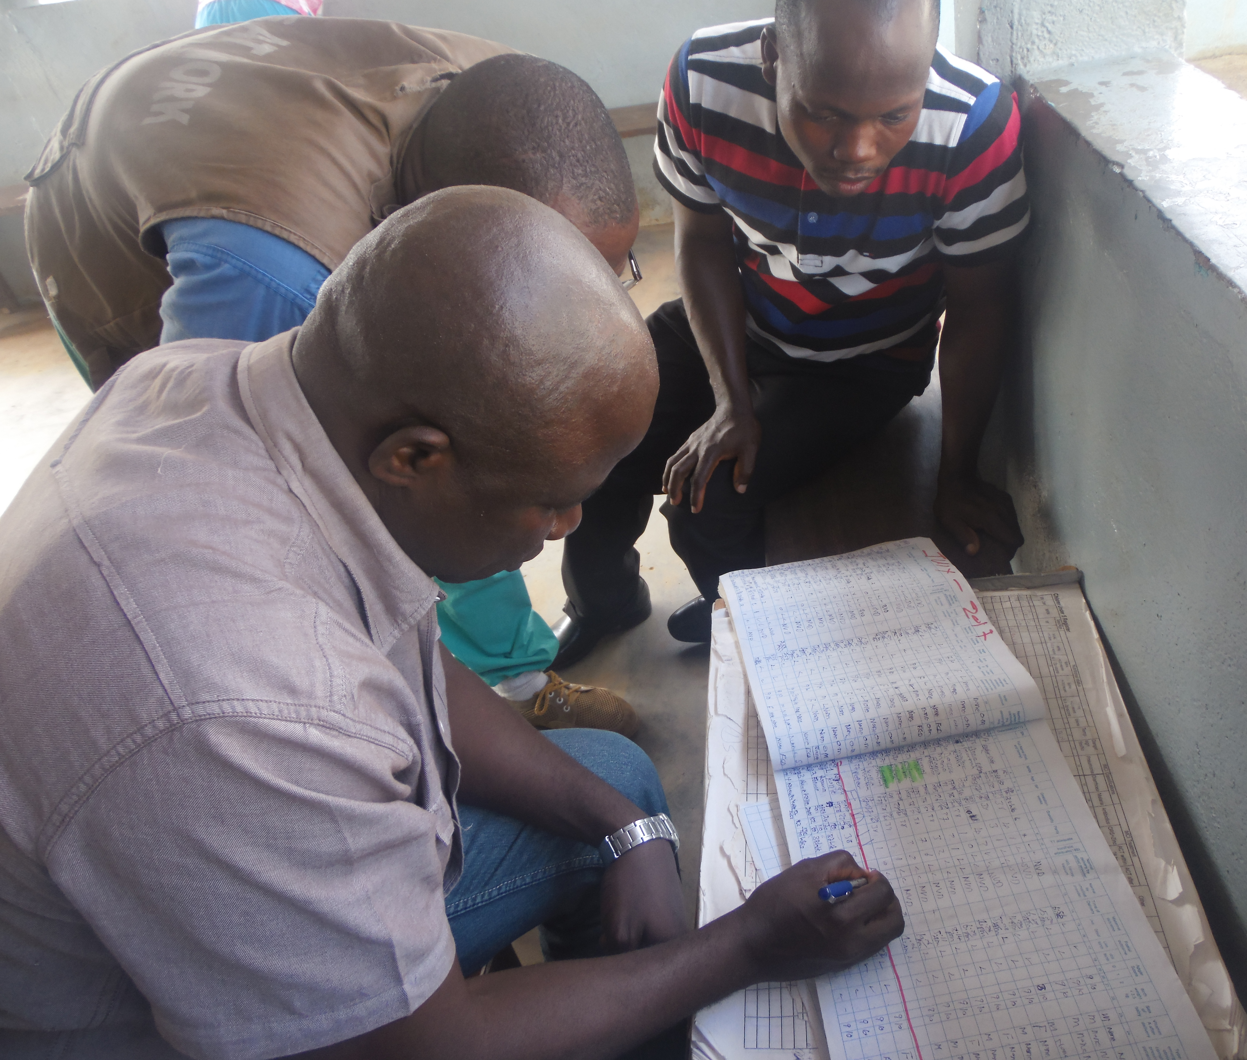

Impact: Data Improves Services & Efficiency
Warehouse infrastructure put in place to maintain drug quality
Improved storage and tracking for mosquito nets and other supplies
USAID was able to implement clear quality requirements and physically verify results.
Investment in accountability and financial management personnel
Notes:
Second, USAID was able to implement clear quality requirements and physically verify results. To date, SI teams travelled to clinics and centers and verified the outputs that were reported. They confirmed that 21,000 pregnant women were tested for HIV, 12,000 cases of child diarrhea were treated, and 31,000 children received diphtheria-tetanus-pertussis immunization.
While these verifications are important on their own, they have a secondary effect of actually improving service delivery. Through monitoring trips, SI has seen that, when hospitals and health centers know they are being monitored and have a clear understanding of how exactly they will be monitored and judged, they make improvements to meet those standards.
IN one warehouse, our recommendations helped teams improve their storage of drug supplies. More durable windows were installed and air conditioners replaced. In another health center, teams used the standards as encouragement to take better care of their mosquito nets for pregnant and lactating mothers. After SIs visits, these nets are now properly shelved, organized, and accounted for. And in three counties, accountants were promoted from local hospitals to the County Health Team level to better support financial management gaps identified during SI’s monitoring.

Slide 7



Liberians Get Value for Money
Healthcare costs rise 7% globally in 2017
54% of Liberians live on < $2 / day
SI helps 590,000 Liberians access healthcare at a lower cost in 2017*
Source: World Bank & Willis Towers Watson
*Reported by Liberian Government to USAID.
Notes:
Ordinary Liberians feel the impact of SI’s work on the cost and quality of their health services.
Healthcare costs are rising globally, and Liberians are ill equipped to cover these costs. Over half the population lives below the poverty line.
SI’s data, and the decisions made by USAID, helped more than half a million Liberians access quality healthcare at a lower cost in 2017.*
(*This is the sum of FARA’s indicator results in PIDS, and beneficiaries may be double counted. But, I feel we can use this figure for an internal SI presentation.)

Slide 8
Tweet: @SocImpactInc Does local ownership affect results? @USAID helps #Liberia increase value for money in health sector with #RBFHealth.
Notes:
Five Bullets that summarize why or how your project had impact:
USAID re-cost the RBF agreement with the GOL to improve its cost-effectiveness in response to a recommendation made by SI in its evaluations.
Because of SI’s recommendation to re-cost the RBF agreement, Liberians received better value from the $24 million invested by GOL and USAID in their health services.
USAID implemented stringent requirements to verify RBF deliverables before reimbursing GOL for costs based on SI’s recommendations in its evaluations.
GOL and USAID improved accountability in Liberia’s health system by linking financing to results and engaging SI to independently monitor these results before reimbursement.
No one was checking up on the work or the quality of the work.

Slide 9
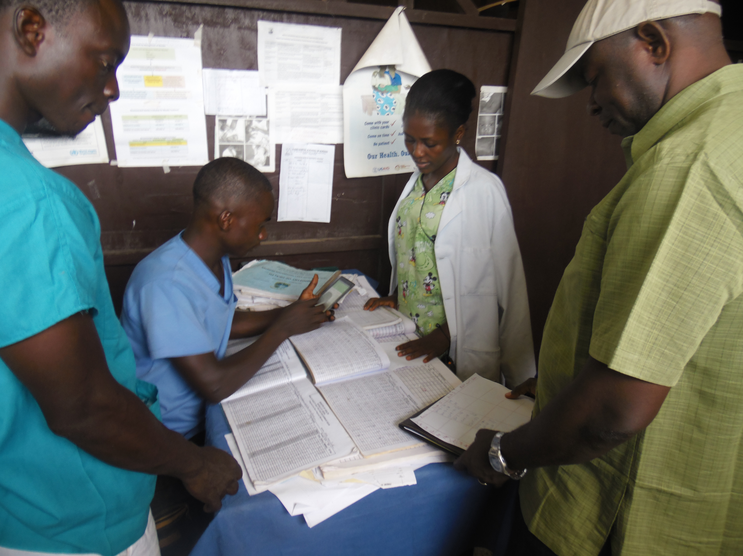
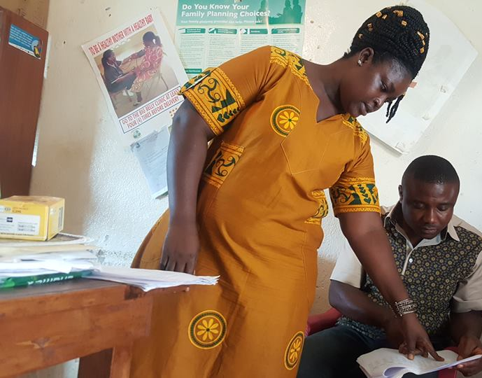



1.GOL Provides Services
SI Evaluates
2. Liberians Receive Healthcare
SI Verifies
Our Social Impact: Integrating Data into Health Service Delivery
3. USAID Reimburses Cost
SI Costs
Notes:
While we have already seen results, SI’s support to the ministry and USAID is not a one time effort. Rather, our services are now integrated into the design of health care service delivery in Liberia. Through ongoing monitoring trips, verification visits and feedback discussions with the Ministry, SIs data and oversight is an integral component of Health Sector support in Liberia

